Slide 1


Aadhaar Pulse AI
Predictive Lifecycle Analytics & Dynamic Resource Optimization
Present by – Rupam Mondal & Kaustab Das
Notes:
1

Slide 2
STRATEGIC VISION
From Reactive Management to Predictive Optimization
The Challenge
The Solution
Managing biometric identity infrastructure for 1.4 billion citizens through static census data and reactive planning creates bottlenecks, citizen dissatisfaction, and resource misallocation.
An intelligent decision support system that forecasts demand surges, detects migration patterns, and optimizes Seva Centre placement in real-time—shifting national identity infrastructure into predictive mode.
Tech Stack: Python, Scikit-Learn, Streamlit, Pandas
Notes:
2

Slide 3



The Paradigm Shift
Current State
Aadhaar Pulse AI
Reactive: Centers built after queues form
Predictive: Deploy 6 months before surges
Static: Fixed population ratios
Dynamic: Real-time Stress Index allocation
Clean Data Only: Anomalies discarded
Zero-Loss: Anomalies mined for fraud signals
5Y
30%
0
Forecasting Horizon
Cost Efficiency
Delay Updates
Predicts mandatory biometric updates years in advance
Mobile vans replace permanent infrastructure for temporary surges
Children's biometric transitions planned proactively
Notes:
3

Slide 4

CRITICAL ISSUES
Three Systemic Problems Holding Back National Identity Infrastructure
The "Clean Data" Paradox
Retrospective vs. Predictive Planning
The "One-Size-Fits-All" Fallacy
Conventional platforms sanitize data by removing duplicates and null values before analysis. The hidden cost: In Aadhaar operations, "bad data" signals operational intelligence—a biometric failure indicates a malfunctioning fingerprint scanner at a specific centre.
Infrastructure planning relies on decadal Census data and lagging indicators. Meanwhile, a district's population might grow 20% in six months due to migrant labour—but official records won't reflect this for years.
Resources assigned using simple ratios (1 centre per 20,000 people) ignore demand diversity. High birth-rate regions need Child Enrolment Camps. Labour influx areas need Update Kiosks for address changes.
Mismatched infrastructure leads to long queues and frustrated citizens.
By cleaning too early, we lose the ground-level insights needed to fix hardware failures and training gaps.
Seva Kendras in migration hubs become overwhelmed while centres in stable areas sit empty.
Notes:
4

Slide 5

Solution Architecture: The Zero-Loss Intelligence Pipeline
The "Tag-and-Keep" Strategy
Five Intelligence Modules
Age-Transition Prediction Engine: Forecasts biological update surges
Unlike standard ETL pipelines that discard problematic data, Aadhaar Pulse AI preserves every signal:
2.Aadhaar Update Stress Index (AUSI): Quantifies infrastructure load
3.Migration & Urban Shift Detector: Classifies district growth patterns
Duplicates: Flagged as potential fraud signals
4.Fraud & Anomaly Radar: Detects operator-level irregularities
Missing values: Tagged as hardware failure events
5.Smart Seva Planner: AI-driven resource allocation recommendations
Anomalies: Analyzed for operational insights
Notes:
5

Slide 6


MODULE 1
Age-Transition Prediction: Biology as a Timeline
01
Deterministic Event Recognition
Every child enrolled at age 0-5 must update biometrics at ages 5 and 15—a biological certainty we can plan around.
02
Historical Data Analysis
Input enrolment data from 5-10 years ago to identify upcoming cohorts requiring mandatory updates.
03
Surge Forecasting
If District A enrolled 5,000 infants in 2020, we predict with 100% certainty a surge of 5,000 updates in 2025.
04
Proactive Deployment
Schedule School Enrolment Camps precisely when demand peaks, eliminating rush at permanent centres.
Business Impact: Ensures timely biometric updates, preventing service denial in school scholarships, ration schemes, and welfare programs while eliminating last-minute infrastructure strain.
Notes:
6

Slide 7
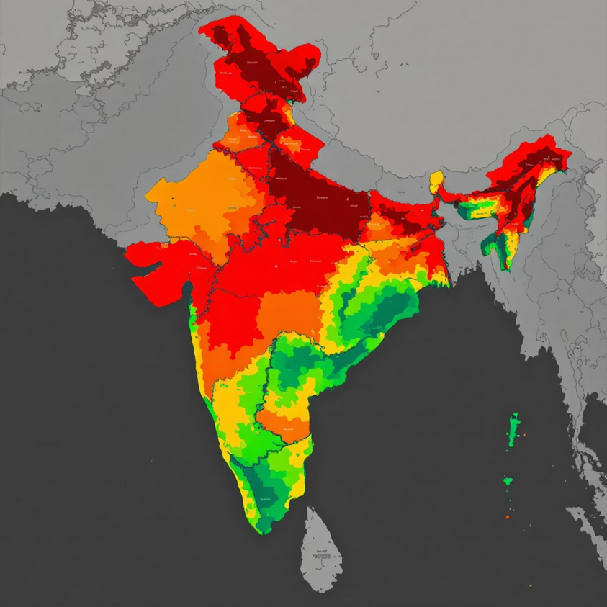

MODULE 2
Aadhaar Update Stress Index (AUSI)
The Proprietary Formula
This metric measures how stressed a district's infrastructure is relative to its capacity—not just absolute volume.
Critical Thresholds
AUSI > 80: System overwhelmed—deploy Mobile Vans immediately
AUSI < 20: Resources wasted—consolidate or relocate centres
Districts "light up" on a real-time heatmap dashboard based on stress scores. A small district with few centres might experience more stress than a large city with abundant infrastructure—AUSI captures this nuance.
Notes:
7

Slide 8

MODULE 3
Migration & Urban Shift Detector: The Growth Matrix
Not all population growth is the same. We classify districts using bi-variate analysis to tailor service responses.
Migration Hubs
Organic Growth Zones
Profile: High address updates / Low births
Profile: Low updates / High births
Examples: Industrial zones, IT parks
Examples: Residential suburbs, rural areas
Action: Deploy Self-Service Update Kiosks (fast, no biometrics needed)
Action: Deploy Door-to-Door Child Enrolment Agents
Ghost Towns
Profile: Low updates / Low births
Examples: Depopulating regions
Action: Switch to "Camp Mode" (1 day/week operations)
Notes:
8

Slide 9

MODULES 4 & 5
Fraud Detection & Smart Resource Allocation
Fraud & Anomaly Radar
Smart Seva Centre Planner
The Isolation Forest model detects statistical impossibilities in data flow patterns:
K-Means clustering analyzes AUSI, migration flux, and volume to generate automated recommendations:
The 500% Spike: Rural centre processing 500 updates/day (avg: 20) signals operator fraud
Red Zone: High stress + High volume → Open new permanent ASK
Duplicate Burst: Rising "Duplicate" errors indicate re-enrolment scams
Flux Zone: High stress + Low volume + Migration → Deploy Mobile Van routes
Sensor Decay: Increasing biometric retries signal scratched scanner glass
Green Zone: Low stress → Monitor only
Notes:
9

Slide 10



Transforming Data Into Foresight
Novel Contributions
Zero-Loss Signal Preservation turning anomalies into intelligence
Biological Forecasting using age cohorts for 5-year demand prediction
Differential Infrastructure matching facility type to growth cause
Future Roadmap
GIS Integration for precise centre location recommendations
WhatsApp Chatbot for citizen queries on nearest empty centres
Hardware IoT Feeds for real-time scanner health monitoring
Aadhaar Pulse AI transforms data from a record of the past into a map for the future—ensuring the government stays one step ahead of every citizen's need.
Conclusion
Notes:
10

Slide 11

Thank You
Notes:
11

